Slide 1
Optimizing GCP Dataﬂow: Running Jobs in Custom Containers - A Comprehensive Guide

Slide 2
is a fully managed service for stream and batch processing. This presentation will guide you through
using to enhance performance and ﬂexibility. Understanding this process is crucial for efﬁcient data processing in modern applications.

Slide 3


Understanding Custom Containers
allow you to package your application along with its dependencies. This means you can use any programming language or library that suits your needs. leverages these containers to run jobs in a more controlled and efﬁcient environment, leading to better resource management.

Slide 4






Benefits of Using Custom Containers
Utilizing in GCP
Dataﬂow provides several advantages such as ,
, and
. This approach allows developers to tailor their processing environments to meet speciﬁc requirements, ultimately improving job execution and reliability.

Slide 5

Setting Up Custom Containers
To set up a custom container for Dataﬂow, you must ﬁrst create a Docker image that includes your application and its dependencies.
Then, upload the image to Google Artifact Registry.
This process ensures that your Dataﬂow jobs can access the necessary code and libraries seamlessly during execution.

Slide 6

Optimizing Job Performance
Optimizing your Dataﬂow jobs involves conﬁguring your
effectively. Considerations include resource allocation, autoscaling settings,
and using the right execution parameters. Proper optimization can lead to signiﬁcant
performance improvements and cost savings in your data processing tasks.

Slide 7
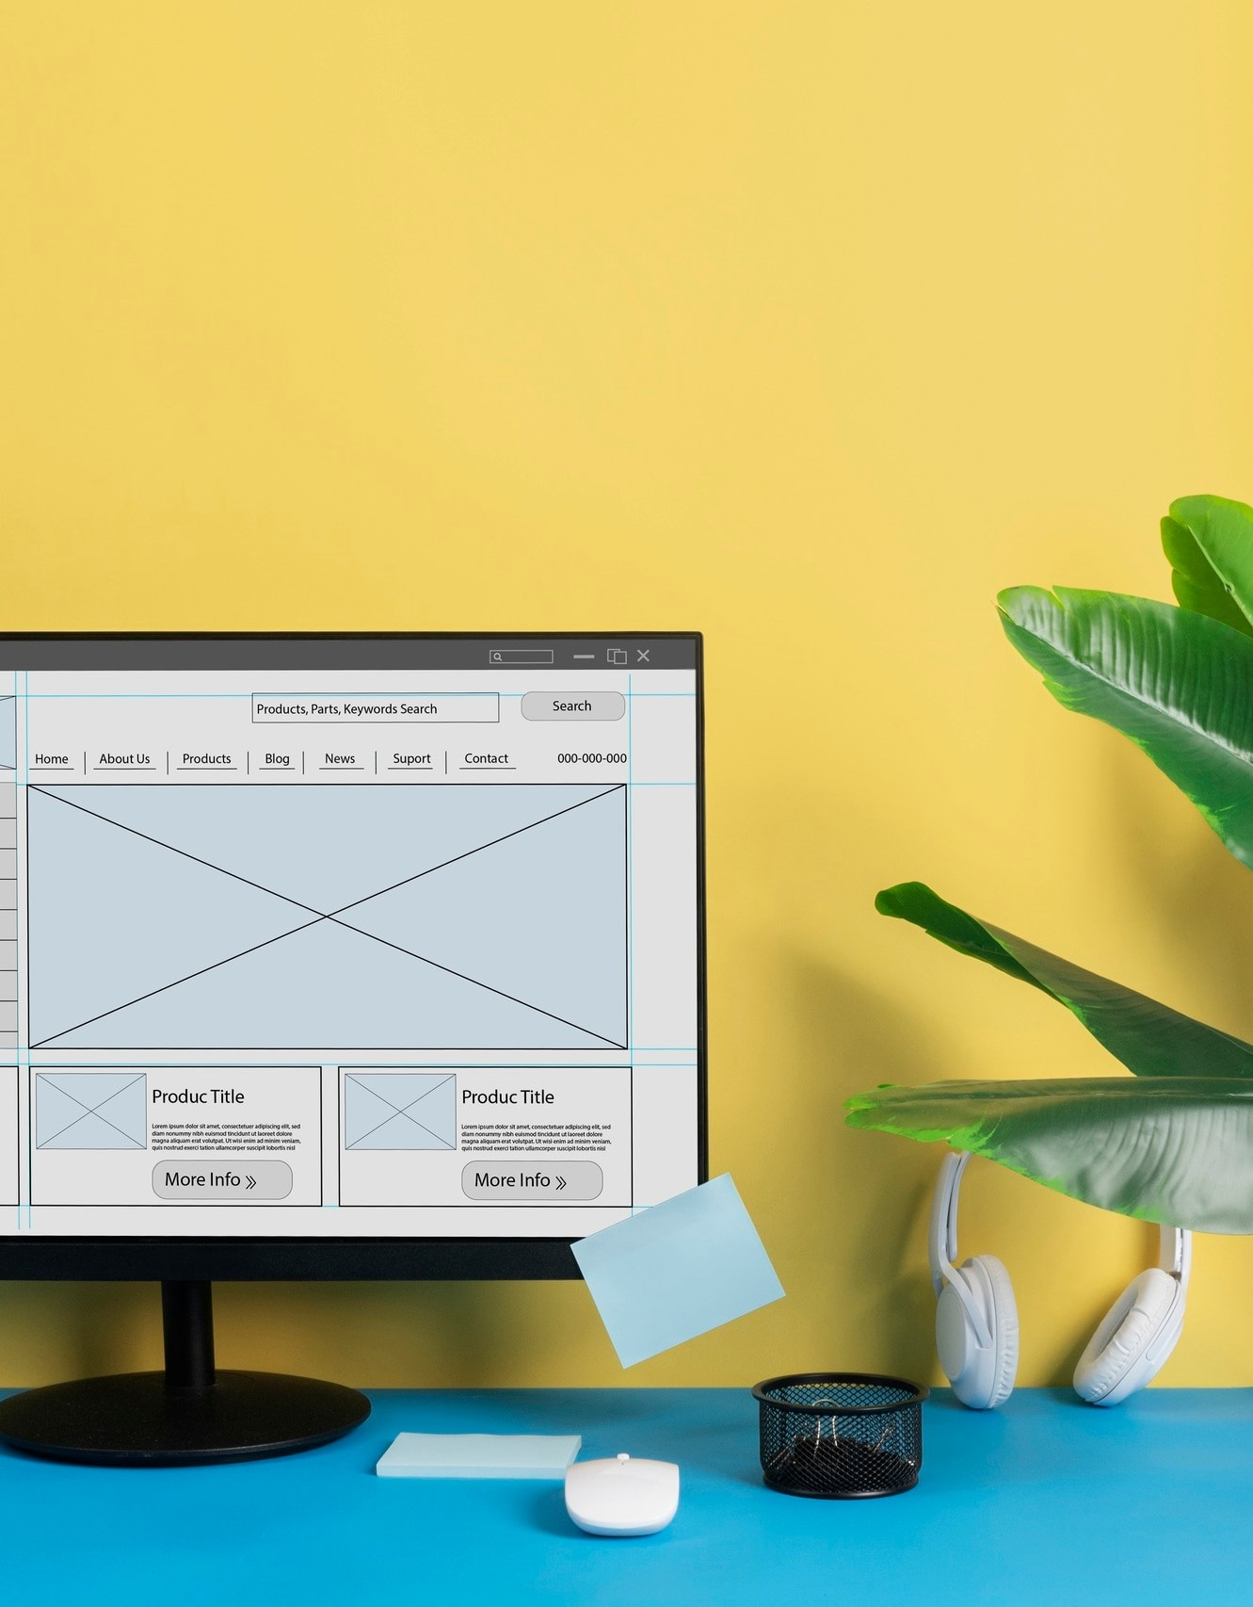
Conclusion and Best Practices
In conclusion,
with custom containers can greatly enhance your data processing capabilities. Always follow best practices such as
, monitoring performance, and adjusting conﬁgurations based on workload. This approach will ensure you get the most out of your Dataﬂow jobs.

Slide 8
Thanks!

